Slide 1
How you can keep your SQL Code protected with GIT
An introduction to GIT and SSDT for DB professionals
Geovanny Hernandez, TheWorkshop Moderated By: Jamilah J
Notes:
[Moderator Part]
Hello and welcome everyone to this PASS Marathon Open Source!
We’re excited you could join us today for Geovanny Hernandez’s session, How you can keep your SQL Code protected with GIT.
This PASS Marathon features back-to-back live webinars, delivered by expert speakers from the PASS community.
The sessions will be recorded and posted online after the event. You will receive an email letting you know when the recordings are available.
My name is Garry Bargsley [you can say a bit about yourself here if you’d like]
I have a few introductory slides before I hand over the reins to Geovanny.
[move to next slide]

Slide 2
Notes:
[Moderator Part]
If you require technical assistance please type your request into the question pane located on the right side of your screen and someone will assist you.
This question pane is also where you may ask any questions throughout the presentation. Feel free to enter your questions at any time and once we get to the Q&A portion of the session, I’ll read your questions aloud to Geovanny.
You are able to zoom in on the presentation content by using the zoom button located on the top of the presentation window.
Please note that there will be a short evaluation at the end of the session, which will pop-up after this session ends in your web browser. Your feedback is really important to us for future events, so please take a moment to complete this.
[Note to Garry Bargsley: You need to determine which questions are the most relevant and ask them out loud to the presenter].

Slide 3
Notes:
[Moderator Part]
Keep learning all year long! Visit pass.org and check out all of the free educational resources available to PASS members.
CONNECT, SHARE and LEARN!
[move to next slide]

Slide 4
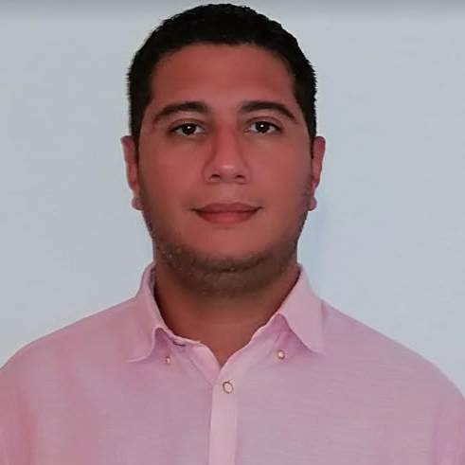



Geovanny Hernandez
DB Engineer / MCT
Database Engineer and Microsoft Certified Trainer, passionate for performance tuning in MS SQL Server, CI/CD, Unit Testing and Python. Looking for opportunities to growing as professional and consultant.
DB Engineer – MCT, TheWorkshop
PASS Volunteer / Data enthusiast
Originally from Nicaragua(central America) lives in Malaga, Spain with his wife and kids. Volunteer in the chapter of PASS Malaga, active member in MSDN forums and enjoys the beautiful beaches in La Costa del Sol.
https://www.geohernandez.net/
@datawithgeo
hi@geohernandez.net
Notes:
[Moderator Part]
This PASS Marathon session is presented by Geovanny Hernandez. Geovanny is a passionate about databases and teaching. He is a Database Engineer and Microsoft Certified Trainer and has more than 12 years experience in the software development. He has been working in different industries such as online games, publishing and banks, involved in migration projects, upgrades and performance tuning on MS SQL Server solutions. Geovanny is also very involved with the SQL Server community specially with the PASS Malaga Local Group in Spain and other virtual events for students and professionals in Universities from Nicaragua (Central America).
[move to next slide]

Slide 5
How you can keep your SQL Code protected with GIT
An introduction to GIT and SSDT for DB professionals
Geovanny Hernandez, TheWorkshop Moderated By: TBA
Notes:
And without further ado, here is Geovanny with How you can keep your SQL Code protected with GIT.
{speaker begins}
**[Speaker takes over]**

Slide 6
AGENDA
Introduction to SSDT – A road to DB DevOps
GIT and keeping your DB code under control

Slide 7
Introduction to SSDT A road to Database DevOps

Slide 8
Why do you must apply DevOps for the Database?
“Our highest priority is to satisfy the customer through early and continuous delivery of valuable software”.
1st principle behind agile manifesto
Notes:
Answer with three key aspect : Faster, better, cheaper which finally give us stability speed stability spped

Slide 9



Tools for starting to work:
https://www.microsoft.com/en-us/sql-server/sql-server-downloads
https://www.microsoft.com/en-us/sql-server/sql-server-downloads
https://docs.microsoft.com/es-es/sql/ssdt/download-sql-server-data-tools-ssdt?view=sql-server-2017#changes-in-ssdt-for-visual-studio-2019
Notes:
Since VS 2019 only requires that you installa an extensión and not download a separate package for SSDT

Slide 10
Source Code control and automated changes
SQL Server Data Tool (SSDT)
Notes:
Mention that SSDT is an integrated component which is part of Visual Studio ecosystem and help us to manage the lifecycle for DB Projects
SQL Server Data Tools (SSDT) is a toolset that allows professional database and application developers to carry out all their database design work for SQL Server and SQL Azure within Visual Studio
The SSDT project system allows developers to have a fully representative source-code backed model of their database for offline development. SSDT Database Projects also enable the database schema to be version controlled using database snapshots and other source code control mechanisms.

Slide 11

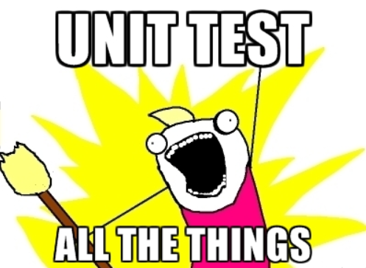
Some benefits of using SSDT
Artifact (DACPAC)
Notes:
Answer with three key aspect : Faster, better, cheaper which finally give us stability speed stability speed
Code integrated into a project
Compile time checking – No artefact is generated if you have error in your SSDT project
A release is a collection of artifacts in your DevOps CI/CD processes. An artifact is a deployable component of your application. DACPAC will be a tangible component use to deploy our DB Changes> new tables, new sp, new data

Slide 12
Why is important to have an Artifact (DACPAC)?
Notes:
Answer with three key aspect : Faster, better, cheaper which finally give us stability speed stability spped

Slide 13

Why do we need a Source Control System?
Notes:
Why GIT – The most used source control in the programming world, every computer is a Server of the code, remember, the develop branch is forced and branch to be sync before to push changes. GIT is a distributed versioning or change tracking system. Every copy of a repository contains the entire history of changes

Slide 14
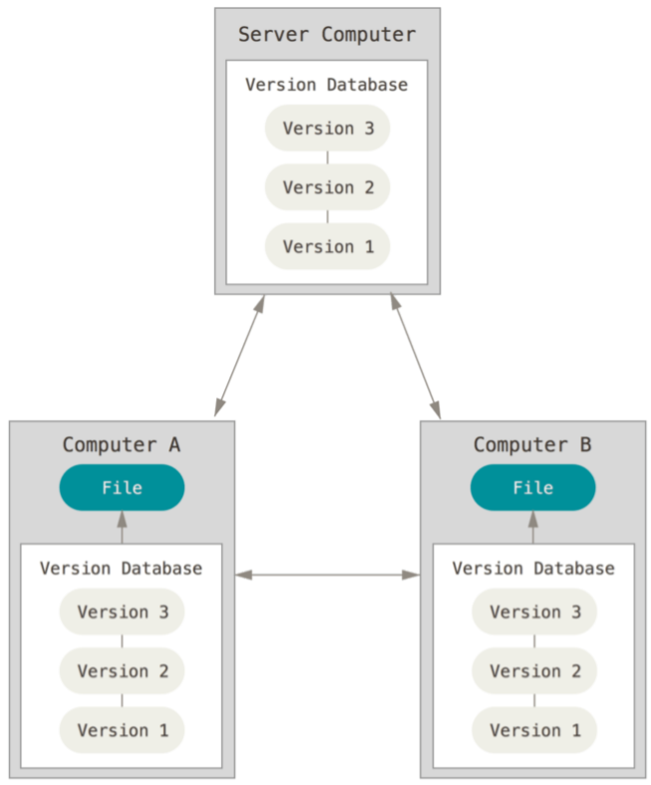
Distributed version control . Credits: Pro GIT – Scott Chacon and Ben Straub
Notes:
What exactly it means? Every computer updated keep the history of every version, it means that if the Server Computer collapse, we can easy restore it taking the project from any available sync computer.

Slide 15
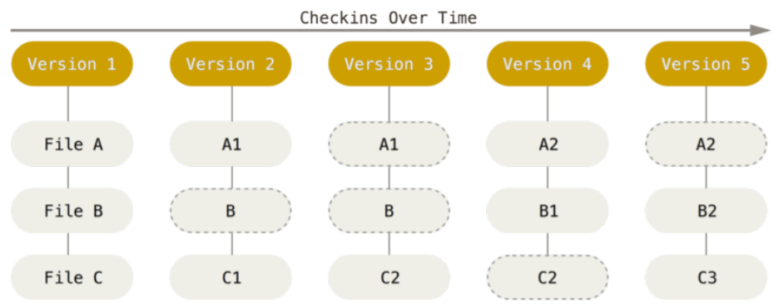
Storing changes as stream of snapshots. Credits: Pro GIT – Scott Chacon and Ben Straub
Notes:
GIT do a checksum before to store anything, everything happen in the repo GIT realizes, the SHA-1 hash algorithm, GIT doesn’t store name, use the hash value of its contents

Slide 16
Set up our Project into a repository GIT in action
Notes:
Open your Azure account and show the process of creating a new empty repository (called SQL Saturday) – Check if it is possible to omit the process of creating and only showing the link for a new simple article about it

Slide 17
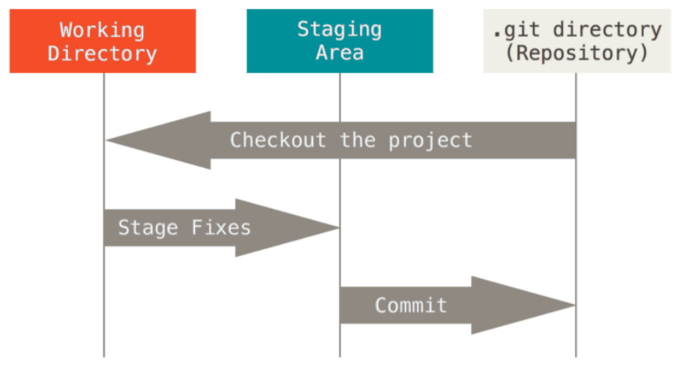
GIT Workflow -- Working tree, staging area, and Git directory. Credits: Pro GIT – Scott Chacon and Ben Straub
Notes:
You modify files in your working tree.
You selectively stage just those changes you want to be part of your next commit, which adds only those changes to the staging area.
You do a commit, which takes the files as they are in the staging area and stores that snapshot permanently to your Git directory.

Slide 18
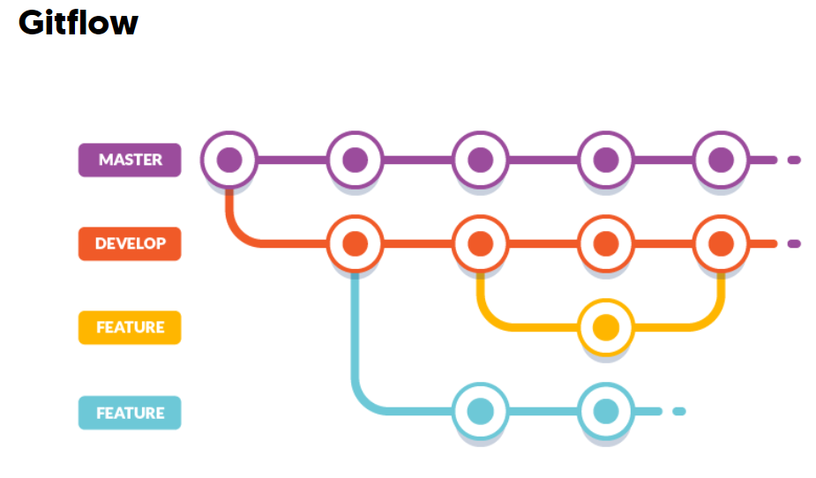
Notes:
Mention the importance

Slide 19
“Pull request… Learning in action
Notes:
A pull request (PR) is a request submitted to a GitHub/AzureDevops/Jira, etc repository to merge code into that project

Slide 20

Why do you should open a Pull Request before to merge?
Team Learning

Slide 21



Some GIT clients

Slide 22
A recap
DevOps on Database
An artifact
Source Control
Team working – Pull request

Slide 23
Questions?
Notes:
[Moderator to Address questions in order of relevance]
[move to next slide]
Coming up next…

Slide 24
An Intro to GIT
Daniel Shrader
Notes:
Stay tuned for our next session, An Intro to GIT with Daniel Shrader.
[move to next slide]

Slide 25
Learn more from Geovanny Hernandez
@datawithgeo
hi@geohernandez.net
Notes:
[Moderator Part]
The moderator’s script will be added in this section after deck submission.

Slide 26
Notes:
This PASS Marathon!

